Slide 1
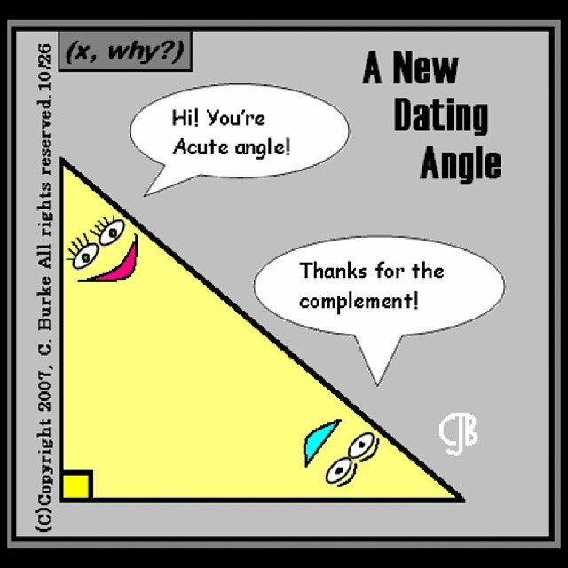
Triangles
EQ: How can we use the angles inside a triangle?

Slide 2
Lesson objective
By the end of this lesson you will be able to;
Calculate the size of angles in triangles
Notes:
Lesson

Slide 3
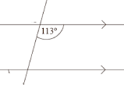
Triangles
EQ –How can we use the angles inside a triangle?
First 5
How big is a revolution?
Alternate angles are_____
Supplementary means__________________
Give 2 angles that are complementary
Draw the diagram and give the value of each angle.

Slide 4
TPS
WICOR
Quickwrite:
Write down all you know about triangles, you have 2 minutes
Share with your shoulder partner
Share one fact your partner said about triangles

Slide 5
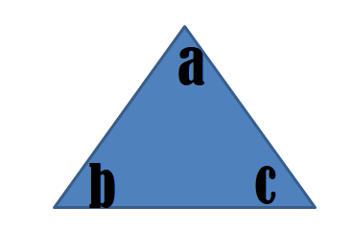
24
7
30
Date
Triangles
EQ –How can we use the angles inside a triangle?
A triangle is a 3-sided shape.
Angles inside a triangle add up to 180°
What is a triangle?
a+b+c=180 degrees
5
Notes:
Lesson objective (EQ)

Slide 6
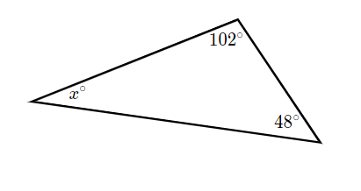
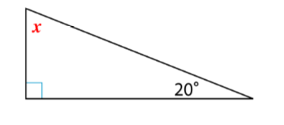
Examples: ADD THESE TO YOUR NOTES
Find the missing angles

Slide 7
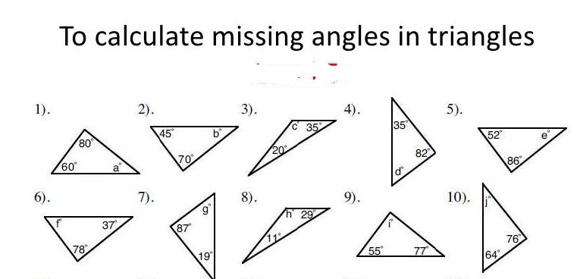

Slide 8
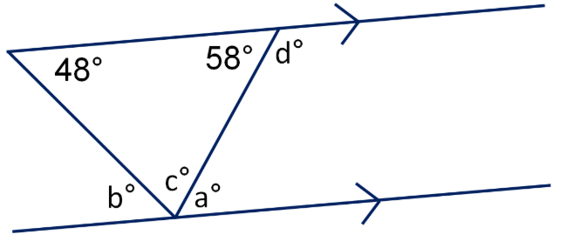
Challenge: Find the values of a, b, c, and d

